Slide 1
BIP 14 - LINK
Protocol Version and User Agent

Slide 2
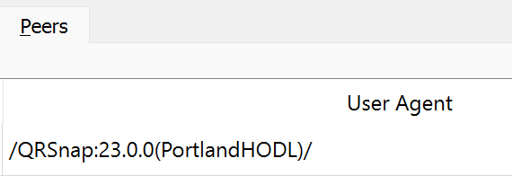



The Goal - Increase Decentralization
BIP 14 suggests splitting the protocol version away from the client version.
This would be similar the changing the version of your web browser but not the version of TCP/IP or HTTP protocols that that browser is communicating through.
This is because there is a definitive difference between the protocol and the client. (e.x. lets say Bitcoin core adds a new RPC for users to access. This would have no effect on the protocol implementation. As such the client version number should increment but the protocol version should not.)
My custom user agent string
or

Slide 3
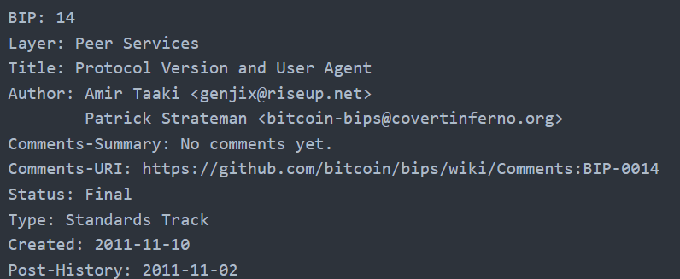
Some details about this BIP to note
This BIP was create very early on in Bitcoin History
Though this BIP is old, it’s still is relevant and maintains the ‘Final’ status

Slide 4
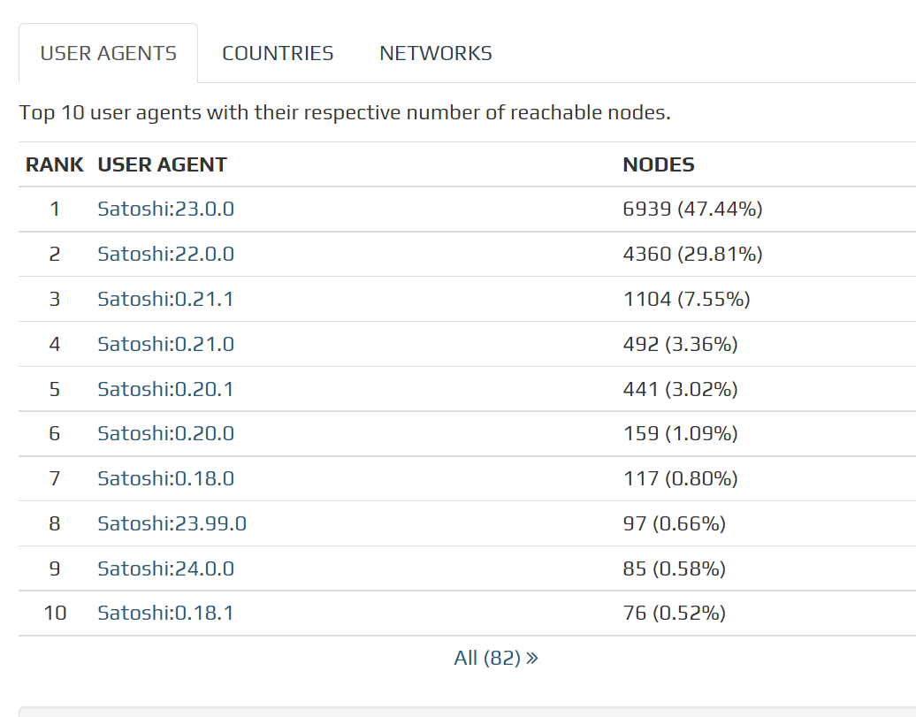
Where can you see this in BIP in practice?
Bitnodes.io is an amazing use of aggregating the statistics of user agent strings.
As you can see because of this bip it’s easy to aggregate statistics of the various clients operating on the network. These clients remain interoperable because of the fact that though their individual version numbers are increasing over time the protocol version seldomly changes.
Bitnodes.io tracks user agent strings - NOT protocol versions

Slide 5
So how does this BIP Split the Protocol and Client Versions?
Network packets ‘version’ and ‘getblocks’ both contain a ‘version’ field. This field represents the version of the Network Protocol. Blocks versions represent the client they were created by.
The ‘version’ packets also contain a sub_version_num this was previously unused and now and now is set to contain the user-agent of the client. These user agents as proposed are a modified implementation of browser user agents.
The sub_version_num has been renamed to user agent and currently has a maximum length of 255 characters.

Slide 6
A ‘BIP’ of History!
The original Bitcoin client was named the Satoshi client.
As time went on other versions and compatible clients were being deployed in a variety of languages (Python, Java, C++, etc …) and were developing their own feature sets. E.g. BitcoinJ, BitDroid, libbitcoin
Because the protocol and version numbers up until this point were linked to each other any increment in the client version incremented the protocol version.
The protocol version is emitted during the following protocol calls ‘version’, ‘getblocks’, and ‘block’ messages to indicate the software used to create the block.

Slide 7
Rationale
With non separated version numbers the Satoshi Client versions also became the new protocol version as well. As such the Bitcoin ‘Satoshi’ Client developers held the rest of the implementations on the network hostage to a degree and with each update of the Saoshi client other non satoshi client could be forced into also updating their version numbers as well.
The protocol should be a shared common collaborative separate from client implementations and allow the Bitcoin network to grow with no or menial fracturing.
So as such the protocol number would not always increment even if there would be an update to the Satoshi client. This is because of the proposed and implemented differetantion between a Client and Protocol implementation.

Slide 8
The 2 Line Summary
Protocol versions represent discrete sets of rules for network communication (protocol) and as such a variation in protocol versions indicates differences such as methods of communication and or features.
The User agent string is no more or less than an informational tool. A vanity plate for your client implementation per say.

Slide 9
Proposed Rules for User Agent Strings
Based on RFC 1945 browser user agents but with more structure
Technically no format is defined only guidelines
Format of … /Name:Version/Name:Version/.../
Version numbers in the form of Major.Minor.Revision (2.6.41)
Repository builds using a date in the format of YYYYMMDD (20110128)
Comments are also allowed as well! - This is done by enclosing the comment into a set of parentheses.
To add this comment the user may add uacomment=’your cool name here’ and it will be applied your user agent string within a set of brackets delimiting a comment!

Slide 10
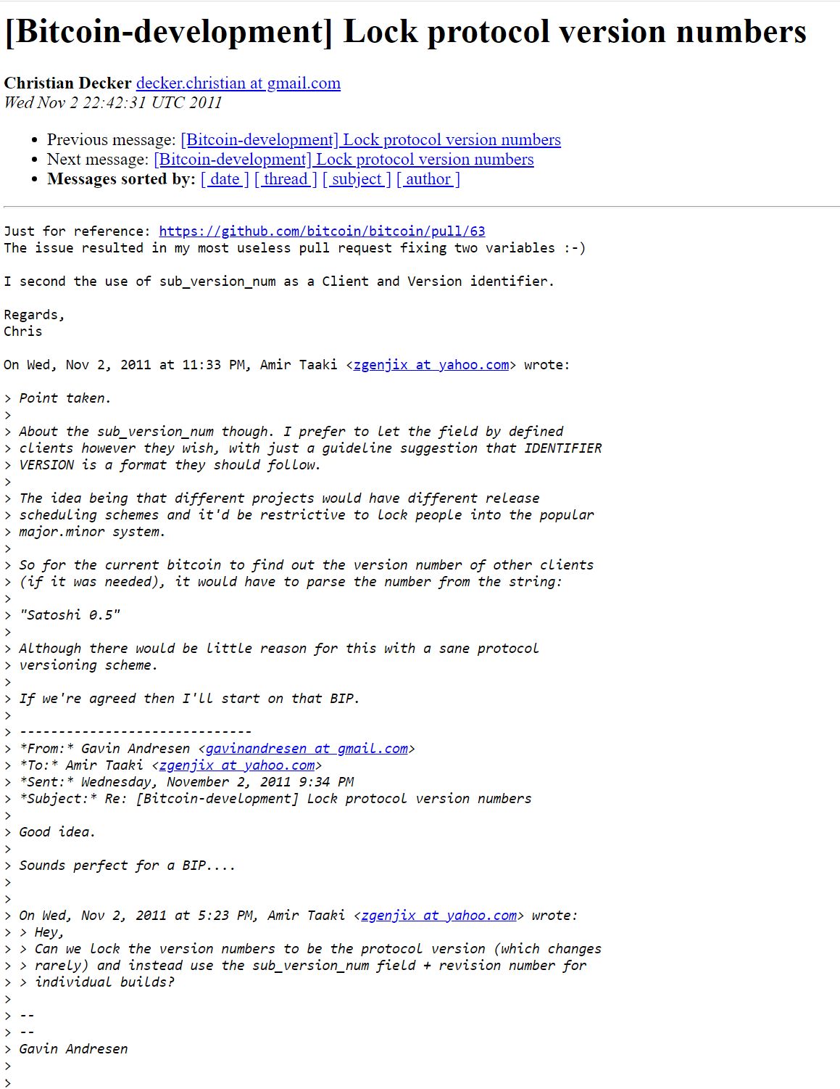
Some cool extras…
Following the thread of BIP 1. The thread on the linux foundation email lists linked is the thread that I believe to be the original discussion that led to this becoming a BIP. Gavin Andresen ACKs the idea as ‘Sounds perfect for a BIP… November 2 2011 was the original thread, BIP submission was one November 11 2011. Others such as Luke-JR also chimed in as well. LINK

Slide 11
Sources
https://github.com/bitcoin/bips/blob/master/bip-0014.mediawiki
https://lists.linuxfoundation.org/pipermail/bitcoin-dev/2011-November/000715.html

